Slide 1
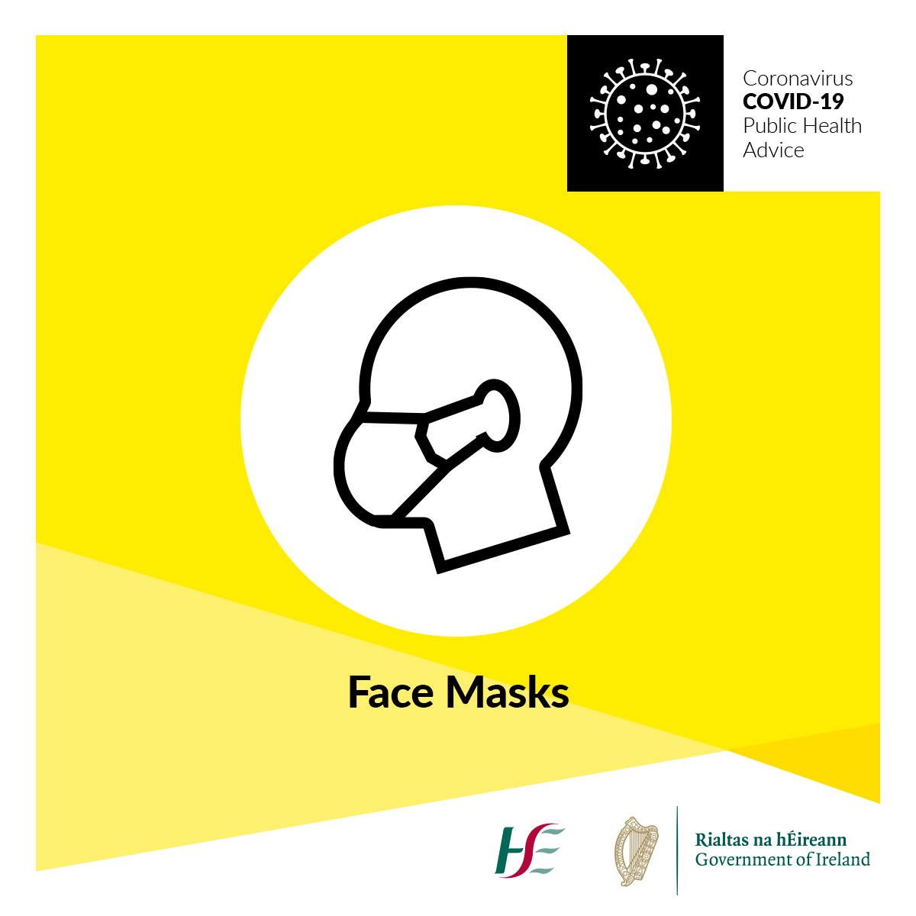
Face coverings and cloth masks
Information campaign 19th June 2020
Stay safe. Protect each other. #HoldFirm

Slide 2
Stay Safe. Protect each other.
Wear a face covering.
Everyone in Ireland has helped to reduce the spread of COVID-19. We have worked together in difficult circumstances to save many lives.
Now that our services and communities are re-opening, we all want to stay safe and keep protecting each other from coronavirus. We do this by cleaning our hands, social distancing and covering sneezes and coughs.
We can also do this by wearing a face covering. Face coverings help prevent people who don’t know they have the virus from spreading it to others.
They should be worn anywhere it’s difficult to stay 2m apart, like shops or public transport, or when visiting anyone who’s more at risk. This includes people aged over 70, or people who are medically vulnerable.
Wear a face covering to show your support for others, and to help in our fight against coronavirus. The HSE will be supporting people to do this with an advertising campaign on radio, social media, posters, search advertising, and on our website, hse.ie, starting on June 15th 2020.
Advertising – Radio and TV
Our media campaign commenced on radio on Monday June 15th, 2020. We have 30’ copy live on all commercial and community stations in Ireland, national, regional and local. This campaign will reach about 87% of the population each week.
Listen to the radio ad here: https://soundcloud.com/user-992575667/face-coverings-june-2020
The TV ads will start on the 23rd June.

Slide 3
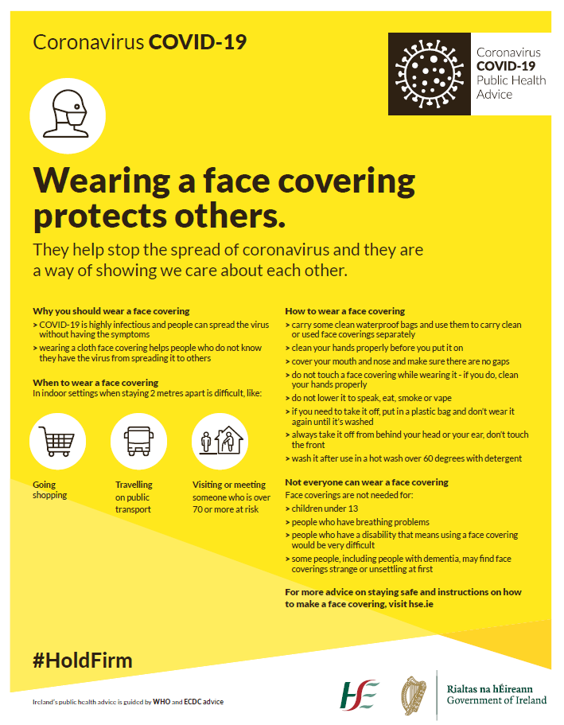
Press advertising
Ads were placed in national press on June 17th, the copy is below for your information.

Slide 4
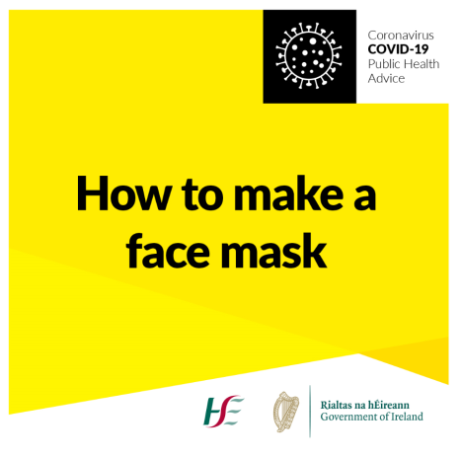
Social Media advertising
We have promoted posts that started from June 15th, on Facebook, Instagram and organic posts on Twitter. The posts will be accompanied by images, guides on how to make a face covering, and links through to detailed content and guidance on HSE.ie.
‘Face coverings can help prevent #coronavirus spread. Here is a guide on how to use them effectively and safely. #COVID19 #HoldFirm #InThisTogether’
‘Face masks can help reduce the spread of the virus by catching droplets of sneezes or coughs. Visit our website to read more on how to make, wear and wash face masks properly. #COVID19’
‘Face coverings help prevent people who don’t know they have the virus from spreading it to others. They should be worn anywhere it’s difficult to stay 2m apart, like shops or public transport. See hse.ie to read more on how to make, wear and wash face masks properly #HoldFirm . #COVID19’
‘Wearing a cloth face covering is recommended in situations where it is difficult to practice social distancing. For example, in shops and on public transport. They may help prevent people who do not know they have the virus from spreading it to others. #HoldFirm #COVID19’

Slide 5
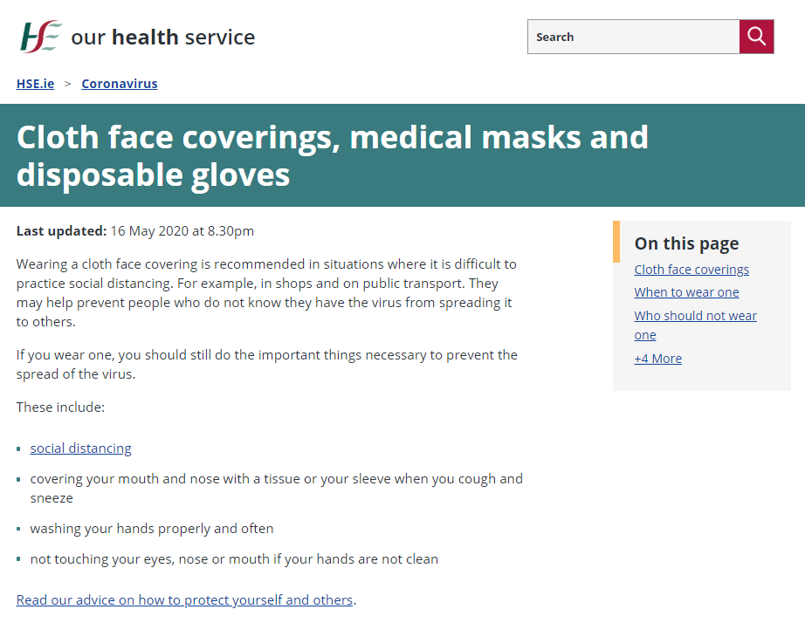
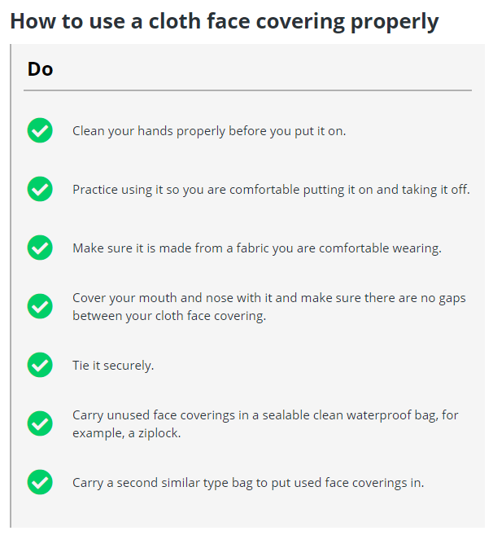
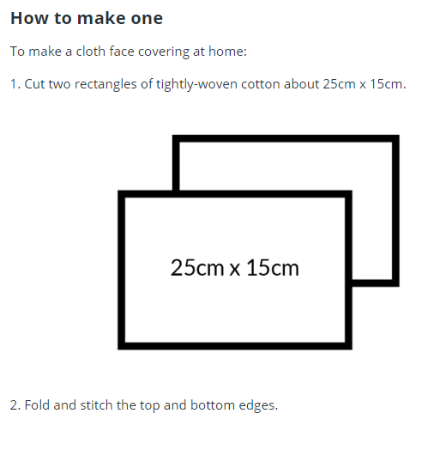
HSE.ie for advice and guidance
As ever, www.hse.ie/coronavirus is the place to go for advice on all aspects of COVID-19, and includes dedicated content to answer your questions on masks and face coverings. Go to https://www2.hse.ie/conditions/coronavirus/face-masks-disposable-gloves.html for information on why and when to wear face coverings, how to make them, and how to safely use them.

Slide 6
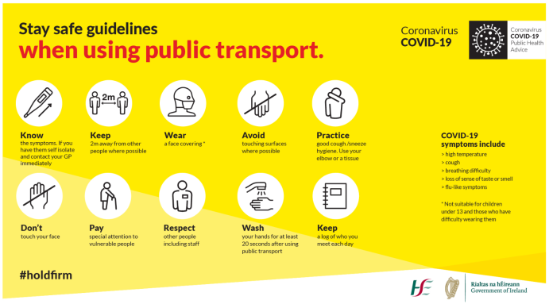
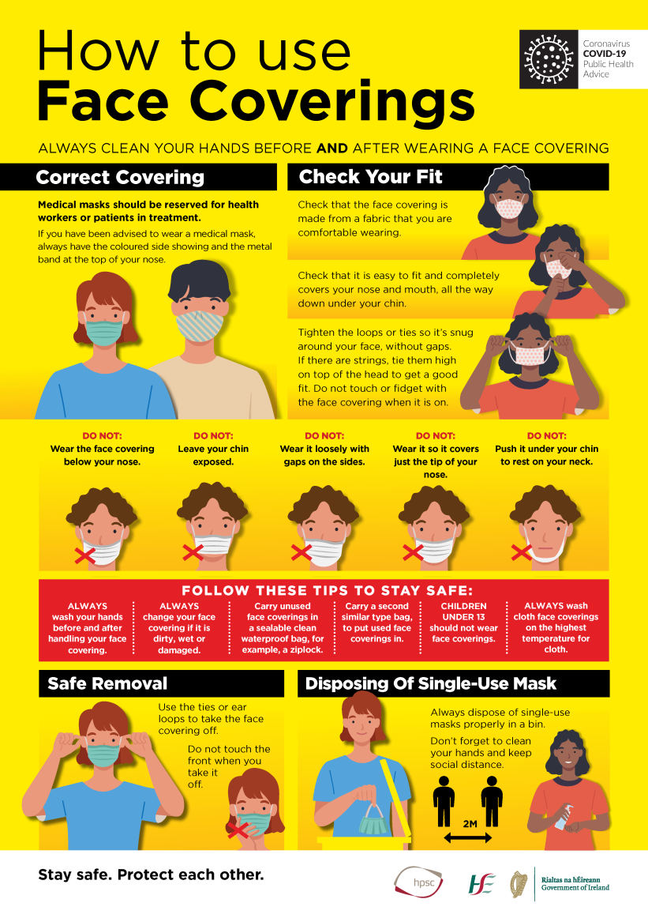
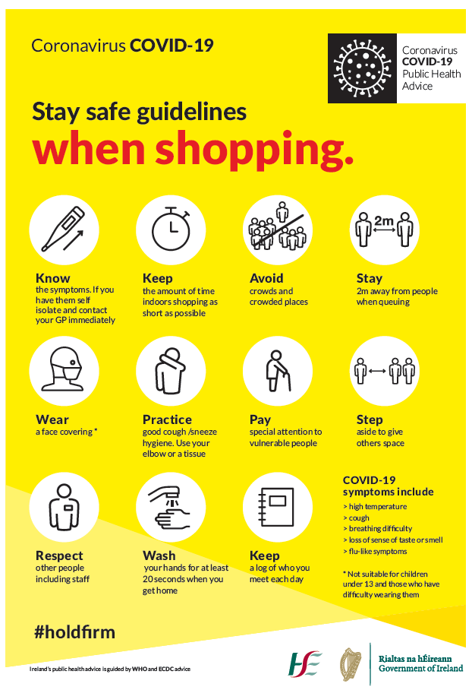
How you can help: Posters and Resources
The HSE and GOV website resources pages have dedicated and helpful posters on face coverings – how to wear, put on and off, store and wash them safely. Please download these posters for your sites, and share electronically.
Download, print and share these posters here:
COVID-19 Face Covering Guidelines Poster Screen
https://www.hse.ie/eng/services/news/newsfeatures/covid19-updates/partner-resources/hse-face-covering-guidelines-poster-screen.pdf
COVID-19 Face Covering Guidelines Poster High Resolution
https://www.hse.ie/eng/services/news/newsfeatures/covid19-updates/partner-resources/hse-face-covering-guidelines-poster-high-resolution.pdf
GOV.ie – Department of Health Stay Safe Guidelines – shopping, public transport
https://www.gov.ie/en/collection/428743-covid-19-coronavirus-physical-distancing-graphics/

Slide 7
How you can help: Social Media
We welcome your help, support and partnership.
Please re-post the messages on face coverings on social media channels or post your own message to encourage your followers to use them. Please also include the short URL directly to the HSE face coverings page: https://bit.ly/2YeJ8Lh.
Support the Face Coverings campaign
Content will be put on the HSE social media channels:
Facebook Page: facebook.com/HSElive
Instagram: instagram.com/irishhealthservice
Hashtags: #COVID19 #HoldFirm #StaySafe’ Twitter handle: @HSELive
For more information
Contact HSE Communications:
digital@hse.ie
www.hse.ie/communications
Stay safe.
Protect each other.
#HoldFirm

